Slide 1
Distortion-Minimizing Injective Maps Between Surfaces
Patrick Schmidt, RWTH Aachen University
Janis Born, RWTH Aachen University
Marcel Campen, Osnabrück University
Leif Kobbelt, RWTH Aachen University

Slide 2
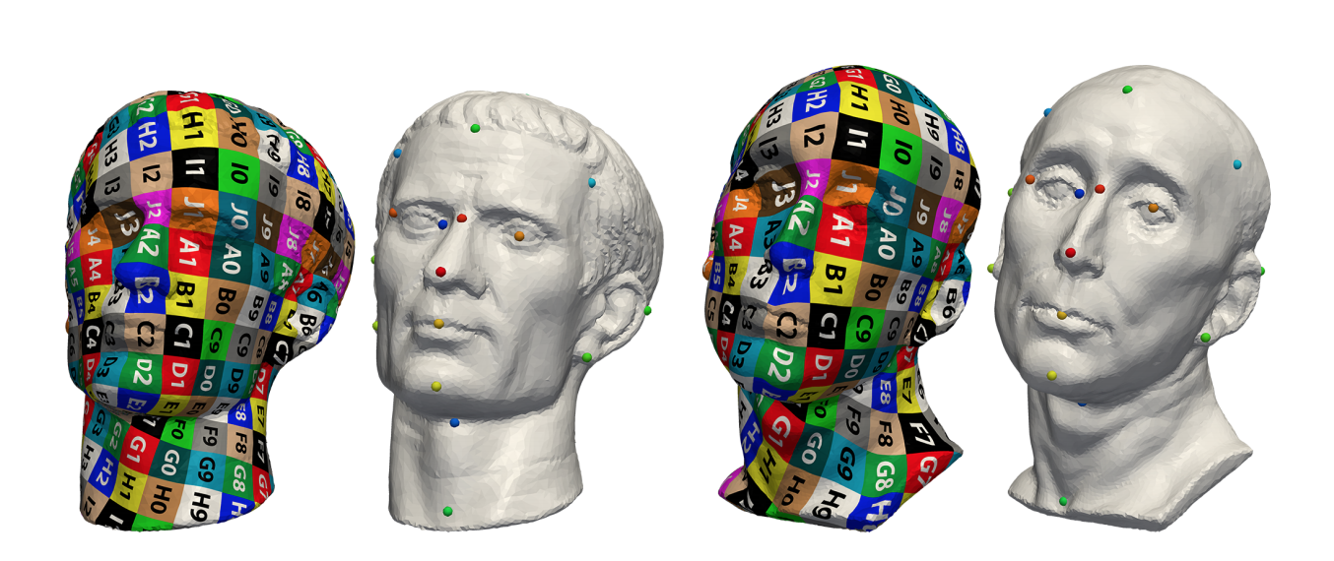
Introduction
Mapping between surface meshes
Information Transfer (such as features, texture) between objects
Shape Co-Process (e.g. co-remeshing, co-segmentation)
Interpolation (e.g. shape morphing)
Embed/Fitting (e.g. model fitting)
Picture from Lifted Bijections for Low Distortion Surface Mappings

Slide 3
Introduction
As surface parametrization, there are several desirable objective
Continuous
Bijectivity
Low-distortion
For some application, ideally such maps should also be
symmetirc
Notes:
The composition of two independently optimized surface-to-plane map does not generally yield an optimal surface-to-surface map.

Slide 4
RELATED WORK – Direct
[Schreiner et al. 2004]
- optimization is performed by locally moving single vertices along random search, requiring multi-resolution approach which is affected by numerical instabilities
[Litke et al. 2005]
- resamples the parameter domain and applies matching techniques, assuming that the surfaces can be mapped to the plane with relatively moderate distortion
[Guskov et al. 2000] [Khodakovsky et al.2003] [Pietroni et al. 2010] [Tarini et al. 2011]
- Tailored to the mapping between one fine and one coarse (base) mesh

Slide 5
RELATED WORK – Indirect
- via the plane
[Aigerman and Lipman 2015; Aigerman et al. 2014, 2015; Kanai et al. 1997; Kim et al. 2011; Lipman and Funkhouser 2009; Litke et al. 2005; Tierny et al. 2011] [Weber and Zorin 2014]
- via the hyperbolic plane
[Aigerman and Lipman 2016; Shi et al. 2017]
- via the sphere
[Aigerman et al. 2017; Alexa 2000; Asirvatham et al. 2005; Baden et al. 2018]
- via a base mesh
[Kraevoy and Sheffer 2004; Praun et al. 2001]

Slide 6
RELATED WORK
Vertex-based Maps: define the map natively for vertices only [Rodol. et al. 2015][Campen et al. 2012; Ezuz et al. 2019a,b; Yang et al. 2018]
Images of other points (on edges or in faces) would have to be deduced if needed
Vertex-to-mesh setting is inherently asymmetric
Non-Sharp Maps: for instance soft maps, [Solomon et al. 2012], functional maps [Ovsjanikov et al. 2012], and optimal transport based maps [Mandad et al. 2017]
Non-Rigid Registration: one surface is deformed so as to conform to the other are [Bouaziz
et al. 2013; Huang et al. 2008; Li et al. 2008b]
Not guarantee continuous, injective maps

Slide 7
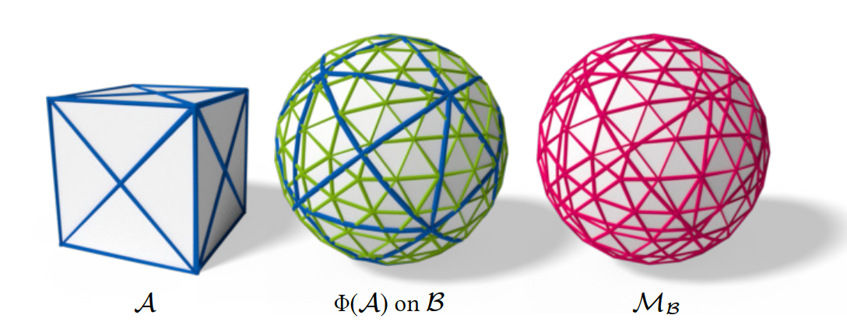
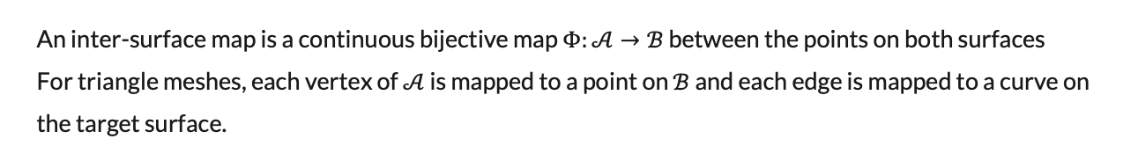
Inter-Surface Maps
An inter-surface map is a continuous bijective map $Φ:𝒜→ℬ$ between the points on both surfaces
For triangle meshes, each vertex of $𝒜$ is mapped to a point on $ℬ$ and each edge is mapped to a curve on the target surface.

Slide 8
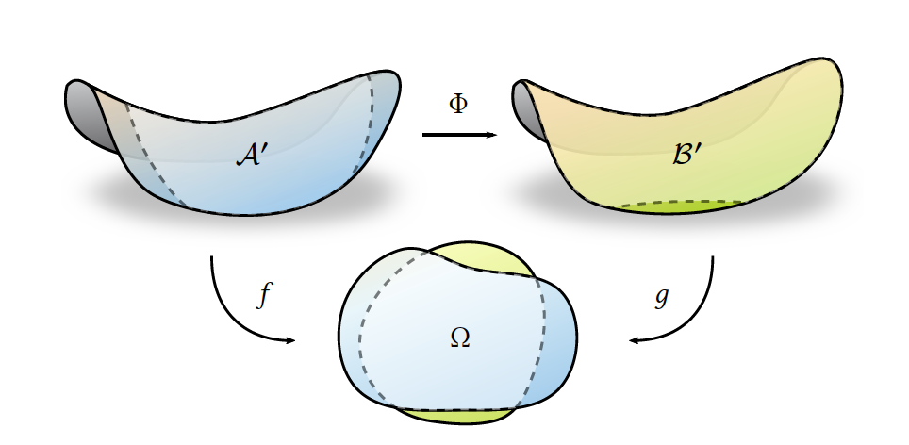
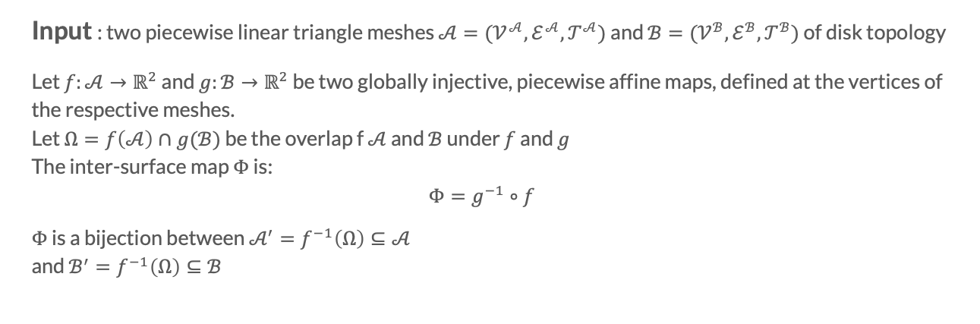
Approach – Formulation
Input : two piecewise linear triangle meshes $𝒜=(𝒱^{𝒜}, ℰ^{𝒜},𝒯^{𝒜})$ and $ℬ=(𝒱^{ℬ}, ℰ^{ℬ},𝒯^{ℬ})$ of disk topology
Let $f:𝒜→ℝ^{2}$ and $g:ℬ→ℝ^{2}$ be two globally injective, piecewise affine maps, defined at the vertices of the respective meshes.
Let $Ω=f\left(𝒜\right)∩g(ℬ)$ be the overlap f $𝒜$ and $ℬ$ under $f$ and $g$
The inter-surface map $Φ$ is:
$$Φ=g^{−1}∘f$$
$Φ$ is a bijection between $𝒜^{′}=f^{−1}\left(Ω\right)⊆𝒜$
and $ℬ^{′}=f^{−1}\left(Ω\right)⊆ℬ$

Slide 9
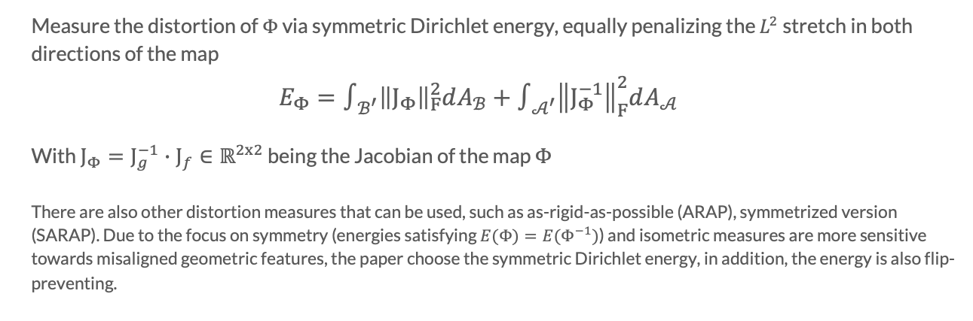
Approach – Distortion
Measure the distortion of $Φ$ via symmetric Dirichlet energy, equally penalizing the $L^{2}$ stretch in both directions of the map
$$E_{Φ}=∫_{ℬ^{′}}{\left\|J_{Φ}\right\|}_{F}^{2}dA_{ℬ}+∫_{𝒜^{′}}{\left\|J_{Φ}^{−1}\right\|}_{F}^{2}dA_{𝒜}$$
With $J_{Φ}=J_{g}^{−1}∙J_{f}∈ℝ^{2x2}$ being the Jacobian of the map $Φ$
There are also other distortion measures that can be used, such as as-rigid-as-possible (ARAP), symmetrized version (SARAP). Due to the focus on symmetry (energies satisfying $E(Φ)=E(Φ^{−1})$) and isometric measures are more sensitive towards misaligned geometric features, the paper choose the symmetric Dirichlet energy, in addition, the energy is also flip-preventing.

Slide 10
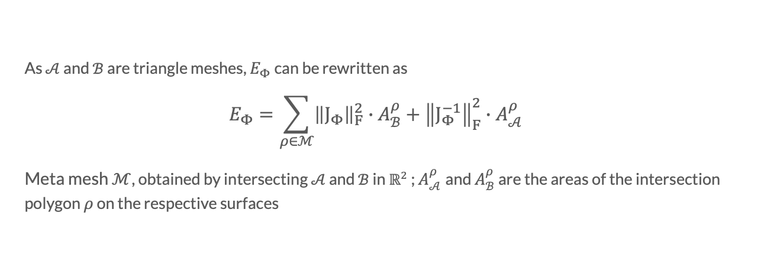
Approach – Distortion
As $𝒜$ and $ℬ$ are triangle meshes, $E_{Φ}$ can be rewritten as
$$E_{Φ}=\sum_{ρ∈ℳ}{{\left\|J_{Φ}\right\|}_{F}^{2}∙A_{ℬ}^{ρ}+{\left\|J_{Φ}^{−1}\right\|}_{F}^{2}∙A_{𝒜}^{ρ}}$$
Meta mesh $ℳ$, obtained by intersecting $𝒜$ and $ℬ$ in $ℝ^{2}$ ; $A_{𝒜}^{ρ}$and $A_{ℬ}^{ρ}$ are the areas of the intersection polygon $ρ$ on the respective surfaces

Slide 11
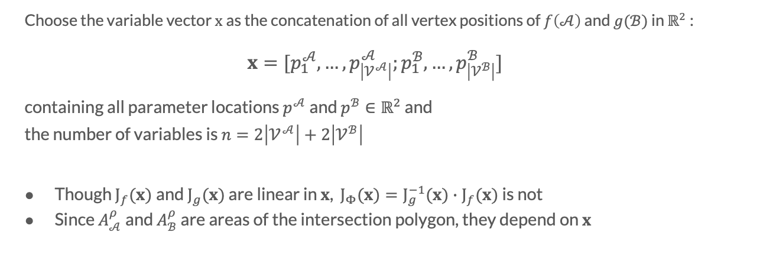
Approach – Optimization Variables
Choose the variable vector $x$ as the concatenation of all vertex positions of $f\left(𝒜\right)$ and $g(ℬ)$ in $ℝ^{2}$ :
$$x=[p_{1}^{𝒜}, …,p_{\left|𝒱^{𝒜}\right|}^{𝒜};p_{1}^{ℬ}, …,p_{\left|𝒱^{ℬ}\right|}^{ℬ}]$$
containing all parameter locations $p^{𝒜}$ and $p^{ℬ}∈ℝ^{2}$ and
the number of variables is $n=2\left|𝒱^{𝒜}\right|+2\left|𝒱^{ℬ}\right|$
Though $J_{f}(x)$and $J_{g}(x)$ are linear in $x$, $J_{Φ}(x)=J_{g}^{−1}(x)∙J_{f}(x)$ is not
Since $A_{𝒜}^{ρ}$and $A_{ℬ}^{ρ}$ are areas of the intersection polygon, they depend on $x$

Slide 12
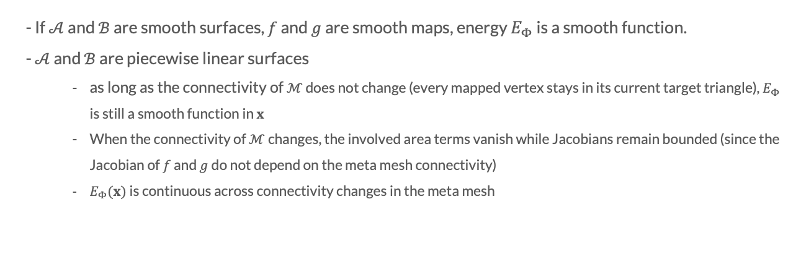
Approach – Continuity of $Φ$
- If $𝒜$ and $ℬ$ are smooth surfaces, $f$ and $g$ are smooth maps, energy $E_{Φ}$ is a smooth function.
- $𝒜$ and $ℬ$ are piecewise linear surfaces
as long as the connectivity of $ℳ$ does not change (every mapped vertex stays in its current target triangle), $E_{Φ}$ is still a smooth function in $x$
When the connectivity of $ℳ$ changes, the involved area terms vanish while Jacobians remain bounded (since the Jacobian of $f$ and $g$ do not depend on the meta mesh connectivity)
$E_{Φ}(x)$ is continuous across connectivity changes in the meta mesh

Slide 13
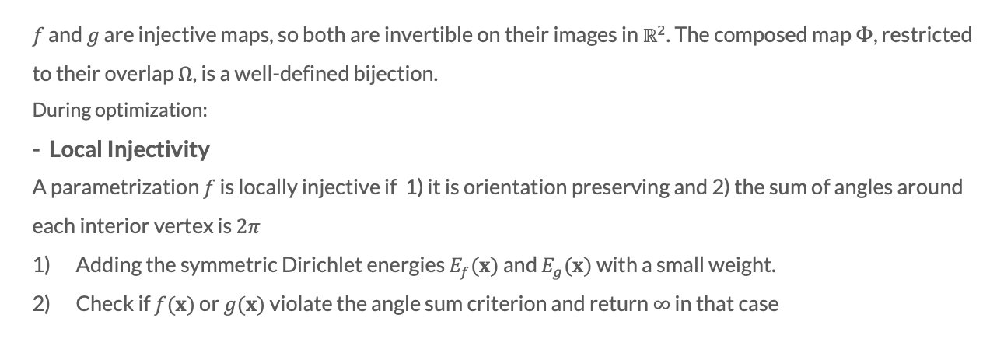
Approach – Injectivity of $Φ$
$f$ and $g$ are injective maps, so both are invertible on their images in $ℝ^{2}$. The composed map $Φ$, restricted to their overlap $Ω$, is a well-defined bijection.
During optimization:
- Local Injectivity
A parametrization $f$ is locally injective if 1) it is orientation preserving and 2) the sum of angles around each interior vertex is $2π$
Adding the symmetric Dirichlet energies $E_{f}(x)$ and $E_{g}(x)$ with a small weight.
Check if $f(x)$ or $g(x)$ violate the angle sum criterion and return $∞$ in that case

Slide 14
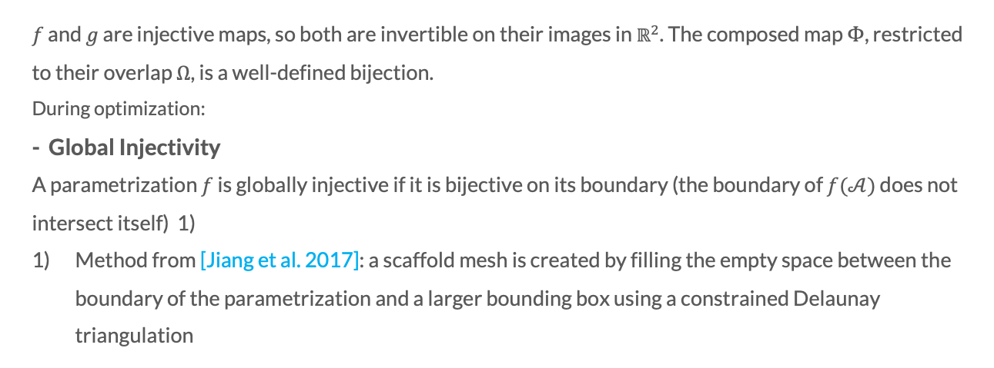
Approach – Injectivity of $Φ$
$f$ and $g$ are injective maps, so both are invertible on their images in $ℝ^{2}$. The composed map $Φ$, restricted to their overlap $Ω$, is a well-defined bijection.
During optimization:
- Global Injectivity
A parametrization $f$ is globally injective if it is bijective on its boundary (the boundary of $f(𝒜)$ does not intersect itself) 1)
Method from [Jiang et al. 2017]: a scaffold mesh is created by filling the empty space between the boundary of the parametrization and a larger bounding box using a constrained Delaunay triangulation

Slide 15
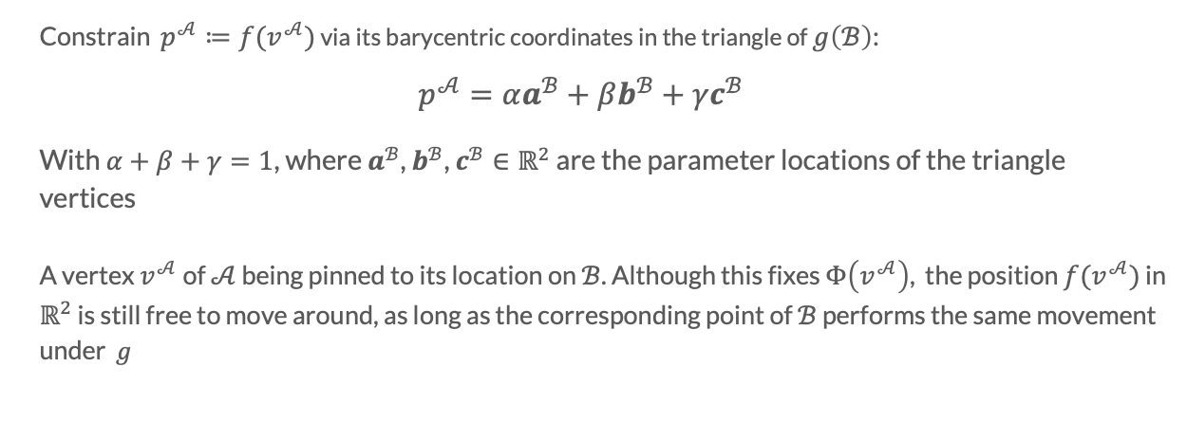
Approach – Position Constraints
Constrain $p^{𝒜}≔f(v^{𝒜})$ via its barycentric coordinates in the triangle of $g\left(ℬ\right)$:
$$p^{𝒜}=αa^{ℬ}+βb^{ℬ}+γc^{ℬ}$$
With $α+β+γ=1$, where $a^{ℬ}$, $b^{ℬ}$, $c^{ℬ}∈ℝ^{2}$ are the parameter locations of the triangle vertices
A vertex $v^{𝒜}$ of $𝒜$ being pinned to its location on $ℬ$. Although this fixes $Φ\left(v^{𝒜}\right)$, the position $f(v^{𝒜})$ in $ℝ^{2}$ is still free to move around, as long as the corresponding point of $ℬ$ performs the same movement under $g$

Slide 16
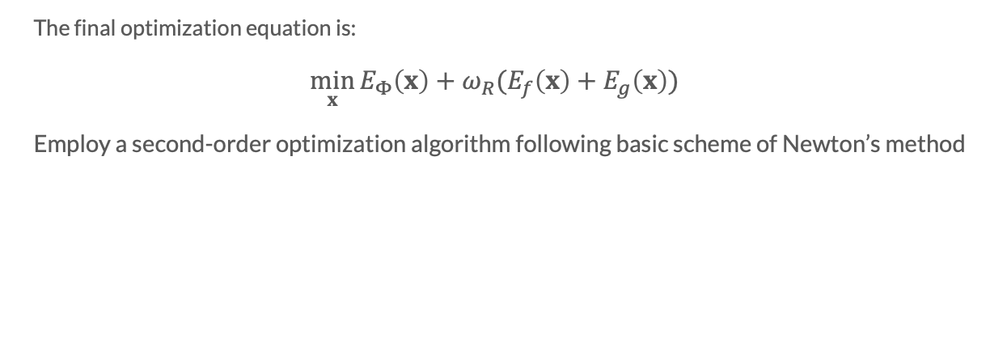
Approach – Optimization
The final optimization equation is:
$$\min_{x}{E_{Φ}\left(x\right)+ω_{R}(E_{f}\left(x\right)+E_{g}\left(x\right))}$$
Employ a second-order optimization algorithm following basic scheme of Newton’s method

Slide 17
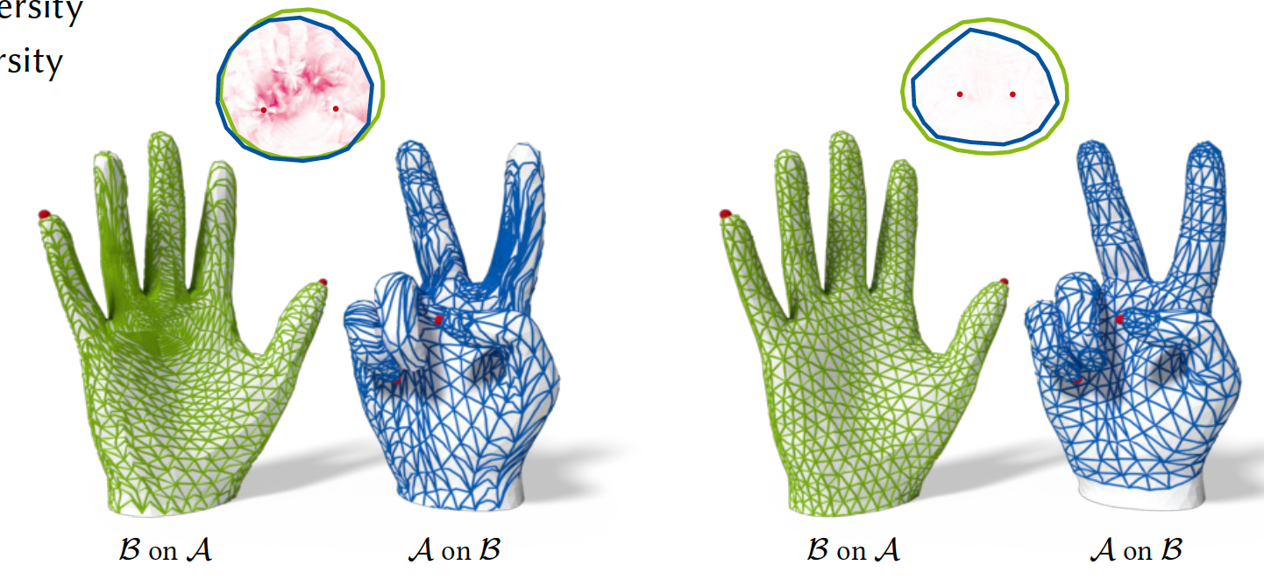
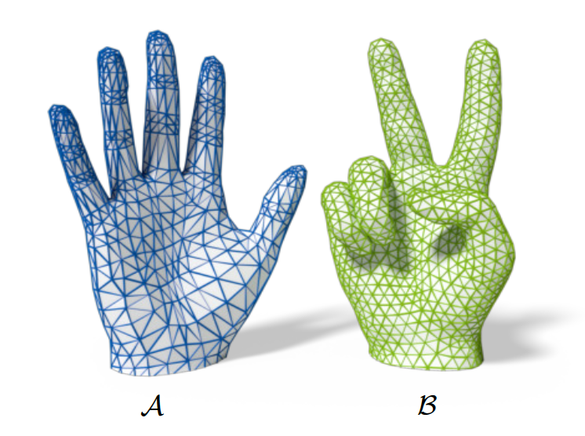
Result

Slide 18
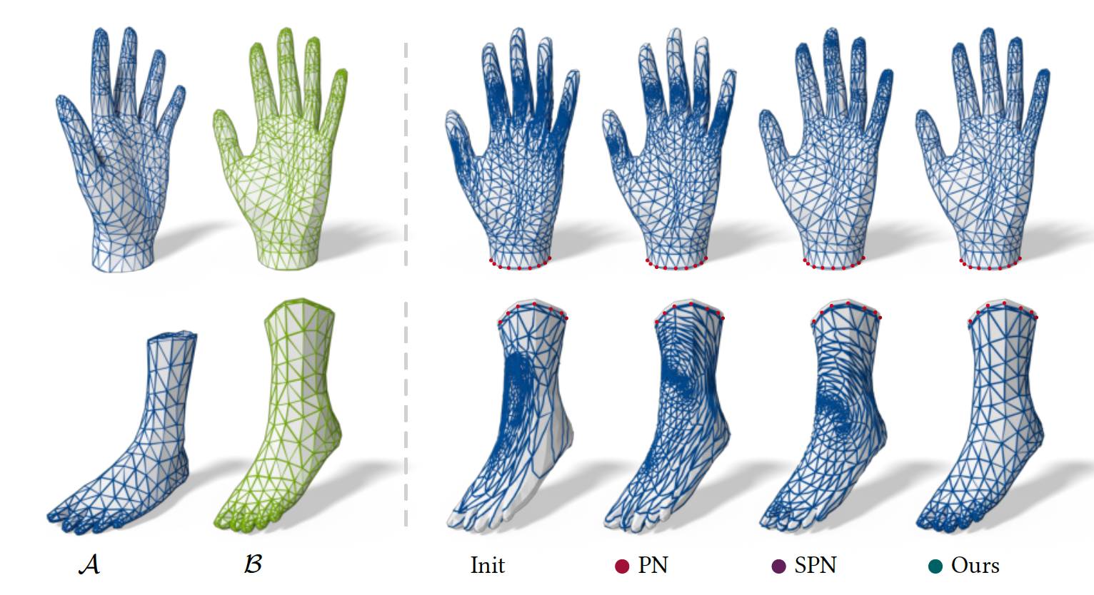
Result

Slide 19
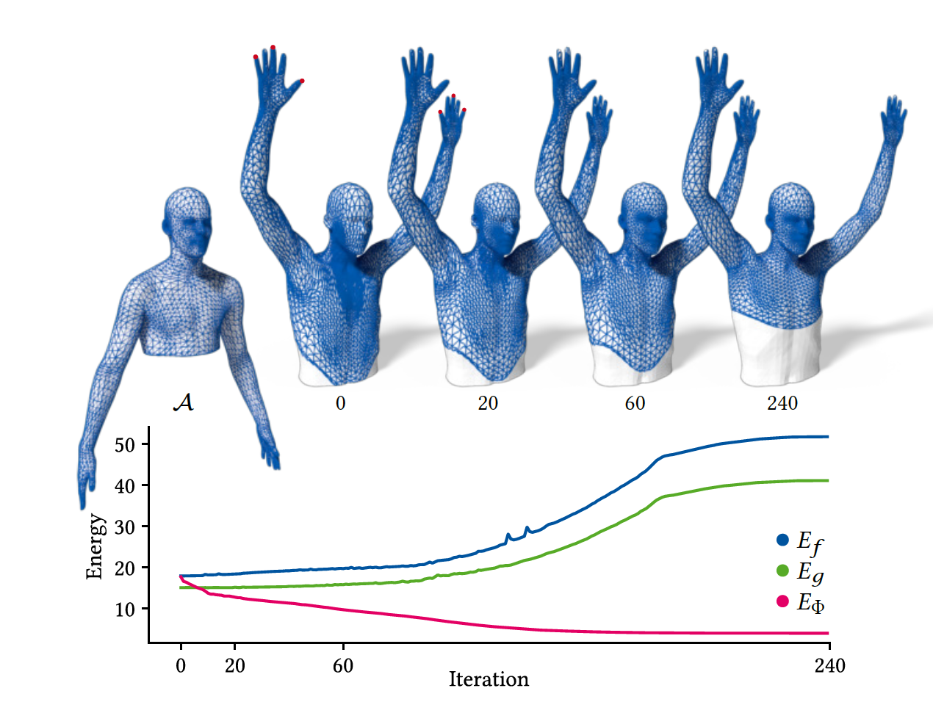
Result

Slide 20
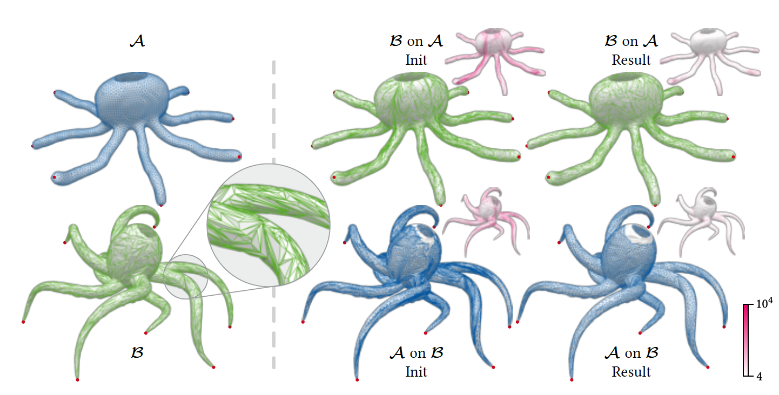
Result

Slide 21
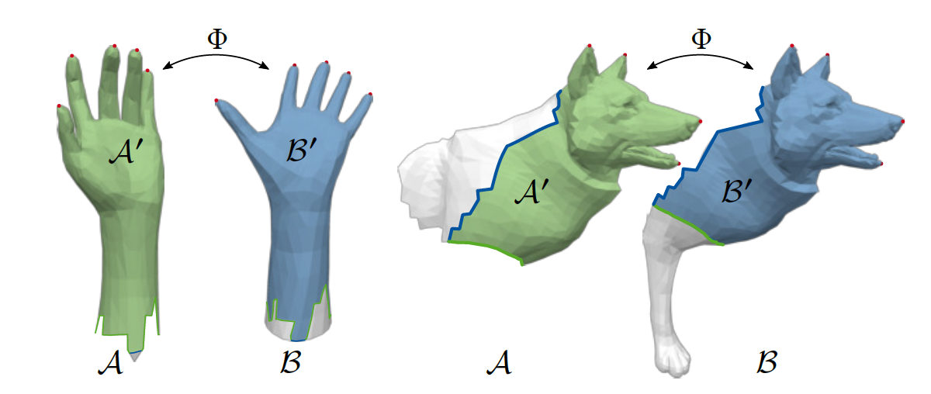
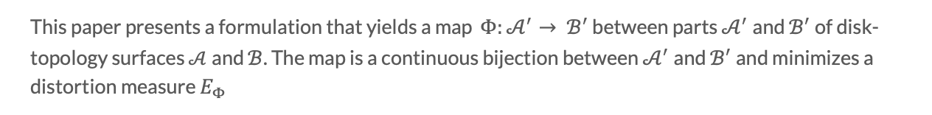
Contributions
This paper presents a formulation that yields a map $Φ:𝒜^{′}→ ℬ^{′}$ between parts $𝒜^{′}$and $ℬ^{′}$ of disk-topology surfaces $𝒜$and $ℬ$. The map is a continuous bijection between $𝒜^{′}$and $ℬ^{′}$ and minimizes a distortion measure $E_{Φ}$

Slide 22
Limitations
Disk-topology requirement
Local minimum

Slide 23
Thank You!

